Slide 1

FAKE NEWS DETECTION USING MACHINE LEARNING
By
m.logashri

Slide 2
Introduction
Problem Statement: The spread of fake news has become a major issue in the digital age, misleading the public and causing harm to society.
Objective: To build a machine learning model that can detect fake news articles and classify them as real or fake.
Significance: Helps automate the process of identifying fake news, improving the reliability of information consumed by the public.

Slide 3
What is Machine Learning?
Definition: Machine Learning (ML) is a subset of Artificial Intelligence (AI) that allows systems to learn from data, identify patterns, and make decisions without explicit programming.
Application:
Machine learning can be applied to tasks such as classification, regression, and clustering, enabling systems to solve complex problems like image recognition, language translation, and fraud detection.

Slide 4
Libraries Used
Pandas: For data manipulation and handling the dataset.
NumPy: For efficient numerical computations on data.
NLTK: For text preprocessing, including stopwords removal and text normalization.
Scikit-learn: For machine learning, model training, and evaluation (e.g., Logistic Regression, TF-IDF Vectorizer).
Matplotlib & Seaborn: For data visualization and model evaluation.
Pickle: For saving and loading trained models and vectorizers.

Slide 5
Data Preprocessing
Text Cleaning:
Removing special characters, extra spaces, and unnecessary words using Regular Expressions.
Converting text to lowercase for uniformity.
Feature Extraction:
Using TF-IDF Vectorizer to convert text data into numerical features for machine learning models.
Splitting the Data:
Data is split into training and test sets to evaluate the model performance.

Slide 6
Model Training
Model Selection:
Using Logistic Regression or Naive Bayes as classifiers for fake news detection.
Training the Model:
The model is trained on the preprocessed dataset to learn the patterns that distinguish real news from fake news.
Evaluation:
Performance is evaluated using metrics like accuracy, precision, recall, and F1-score.

Slide 7
Prediction Example
Manual Input:
The user enters a news article or headline to be classified.
Prediction:
The text is preprocessed, transformed using the TF-IDF Vectorizer, and then classified by the model.
Output:
The system predicts whether the news is real or fake.

Slide 8
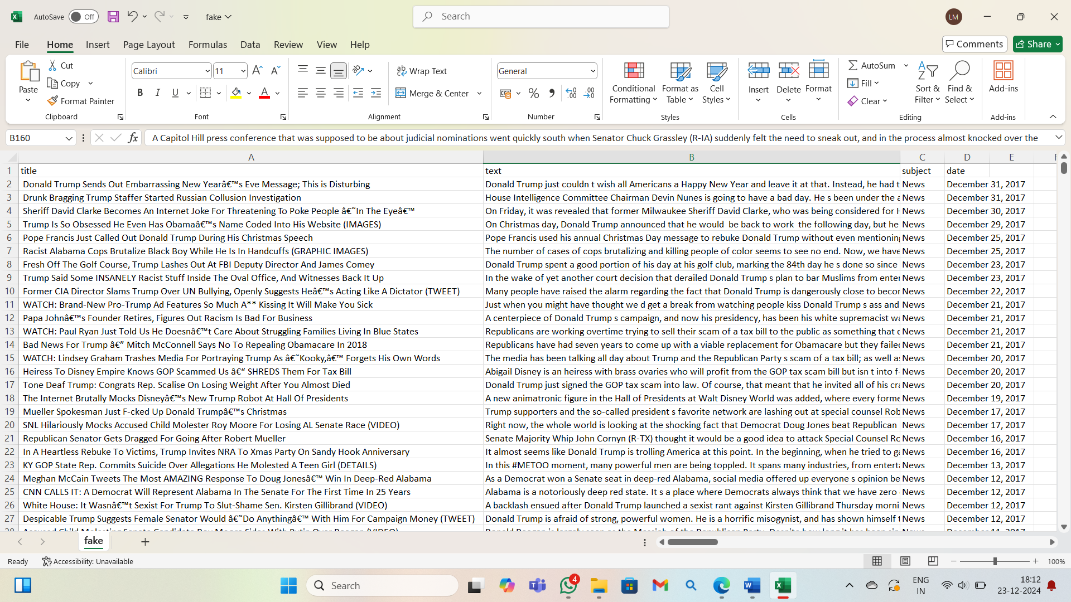
news.csv Excel file

Slide 9
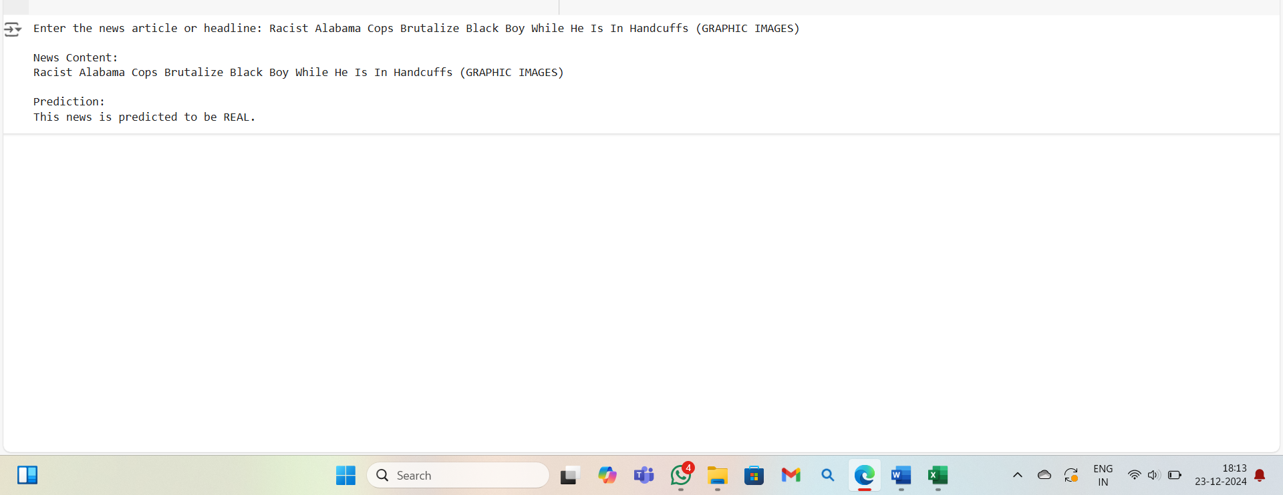
Output :

Slide 10
THANK YOU!

